Slide 1
Please note there are speaking notes/scripts for each slide in this presentation, located in the ‘notes’ section under each slide.
You can delete this slide before presenting.

Slide 2
Notes:
Introduce yourself with some background about who you are, why you are presenting and why you are supporting R U OK? in Trucks & Sheds.
You may want to add an Acknowledgement of Country. Example: I acknowledge First Nations peoples and the land on which we are meeting today [insert the country if you know it]. I pay my respect to Elders past, present and future.

Slide 3
Notes:
If today’s talk brings up tough emotions for you it’s OK to excuse yourself. If you need some extra support, I strongly encourage you to open up to someone you trust, connect with a trusted health professional, or access a service like Lifeline which is available 24/7 on 13 11 14.
You could add information about how to access your Employee Assistance Programme (EAP) if you have one.

Slide 4
Notes:
Today I’m going to share with you:
A bit about the R U OK? in Trucks & Sheds initiative
The 2024 message for our national day of action
How to ask R U OK?
Helpful tools and resources that you can use

Slide 5
Notes:
Healthy Heads in Trucks & Sheds Foundation promotes the prevention and understanding of mental health issues that exist across the road transport, warehousing and logistics industries.
R U OK? is a public health promotion charity that inspires and empowers people to meaningfully connect with those in their world and lend support when they are struggling with life.
These two organisations have come together to empower people in these industries to meaningfully connect and genuinely ask, ‘are you OK?’

Slide 6
Notes:
The national day of action for R U OK? in Trucks & Sheds is a time for workplaces and communities come together to connect, share stories and become better equipped to have these conversations
This is our third year of this conversation movement.
But of course, every day is the day to ask R U OK? because regular and meaningful conversations help us get to know the routines and behaviours of our workmates, which can help us spot the signs that they might not be OK.
This is what you are a part of – an initiative empowering people to build a culture that we can all be proud of. Thank you for your support so far.

Slide 7
Notes:
This year, the message is:
Ask R U OK?
No qualifications needed
This is about letting everyone know that you don’t need to be an expert to have an R U OK? conversation.
Simply listening, giving people your time, and showing them that you care, might be just what they need to help them through.
We all have what it takes to ask a mate or colleague R U OK?

Slide 8
Notes:
To demonstrate this, we wanted to show you all the things you’re already confidently doing without qualifications…

Slide 12
Notes:
These scenarios show that we are constantly talking about things we’re not experts on.
We can channel that same confidence into asking our mates R U OK?

Slide 13
Notes:
This video is available to download at: https://vimeo.com/929729545

Slide 14
Notes:
Now I’ll be sharing some practical tools and tips on how to have an R U OK? Conversation. The idea is to you build your confidence to have a conversation with someone you think might be struggling with life's ups and downs.

Slide 15
Notes:
To know who to ask, you can keep a look out for the signs that someone isn’t themselves.
You might notice changes in what they’re saying or doing, or things that are happening in their life, like relationship breakdown, cost of living pressures, or grief and loss, amongst other things.
When you notice these signs, it’s time to ask.
Question for the audience:
What are some signs that might indicate someone needs support?
Possible answers:
They might seem angry or easily irritated
They might be withdrawn or switched off
They might get dismissive or defensive
They seem exhausted or they’re missing shifts
They are having trouble concentrating
They might be expressing that they feel like a burden or are concerned about the future

Slide 16
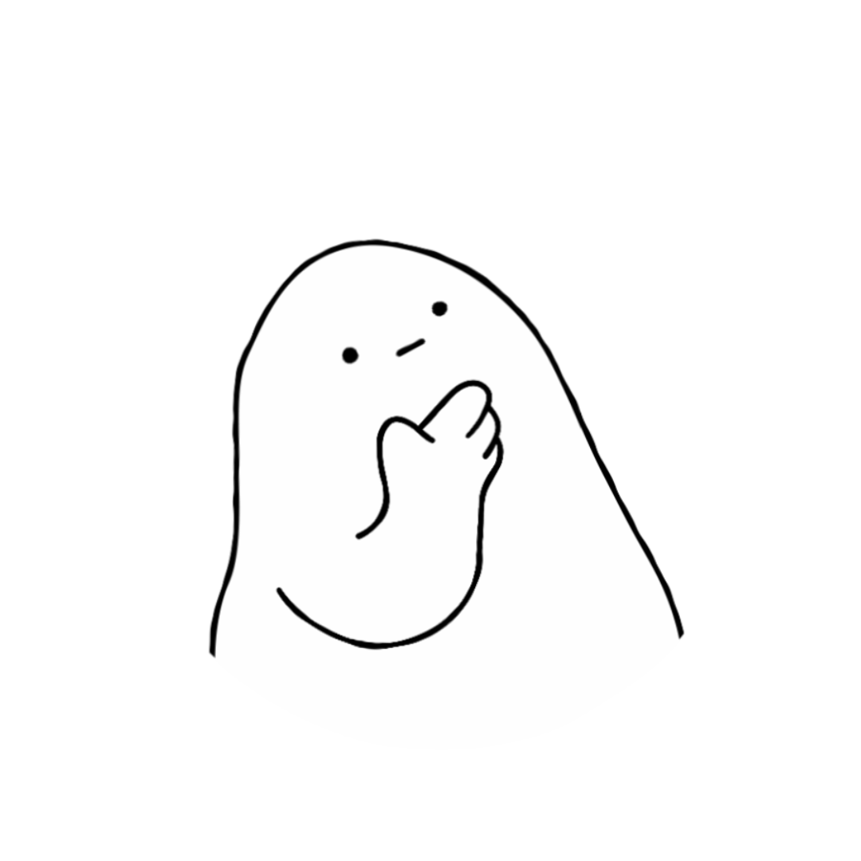
Notes:
Before you can support someone else, you need to look after yourself. And that’s OK. You might not be in the right headspace or maybe you’re not the best person for the conversation. If that’s the case try to think of someone else in their support network who could talk to them.
To help you decide whether you’re ready to start a meaningful conversation, ask yourself:
Am I ready? - Am I in a good headspace and ready to genuinely listen?
Am I prepared? - Have I reminded myself that it’s OK to not have all the answers? Am I prepared for a possible emotional reaction?
Have I picked my moment? – Have I chosen somewhere private? Have you picked a convenient time for you both? If they say they don’t have time, you can arrange for another time.

Slide 17
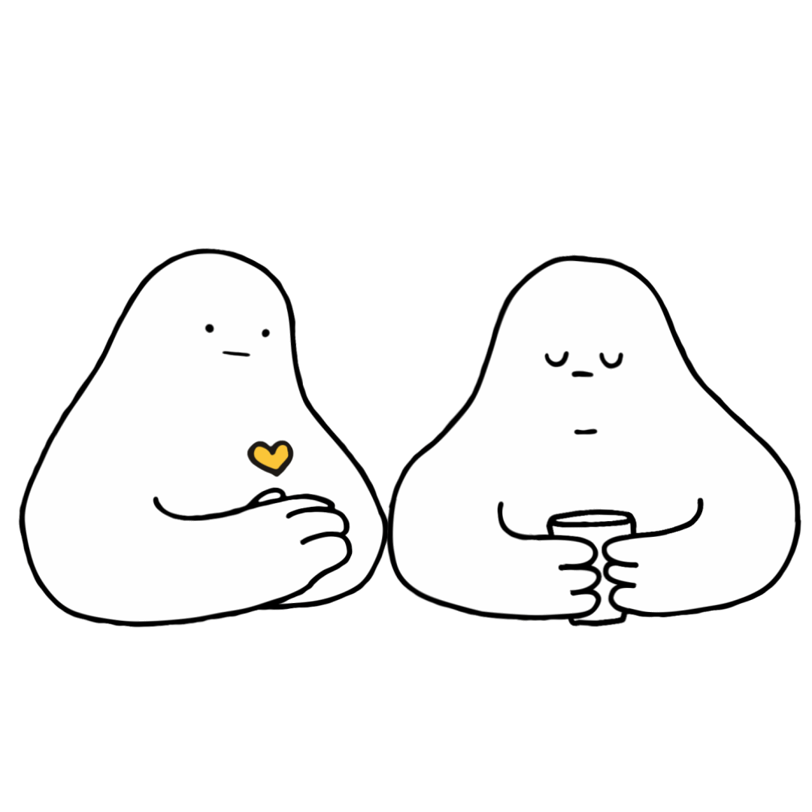
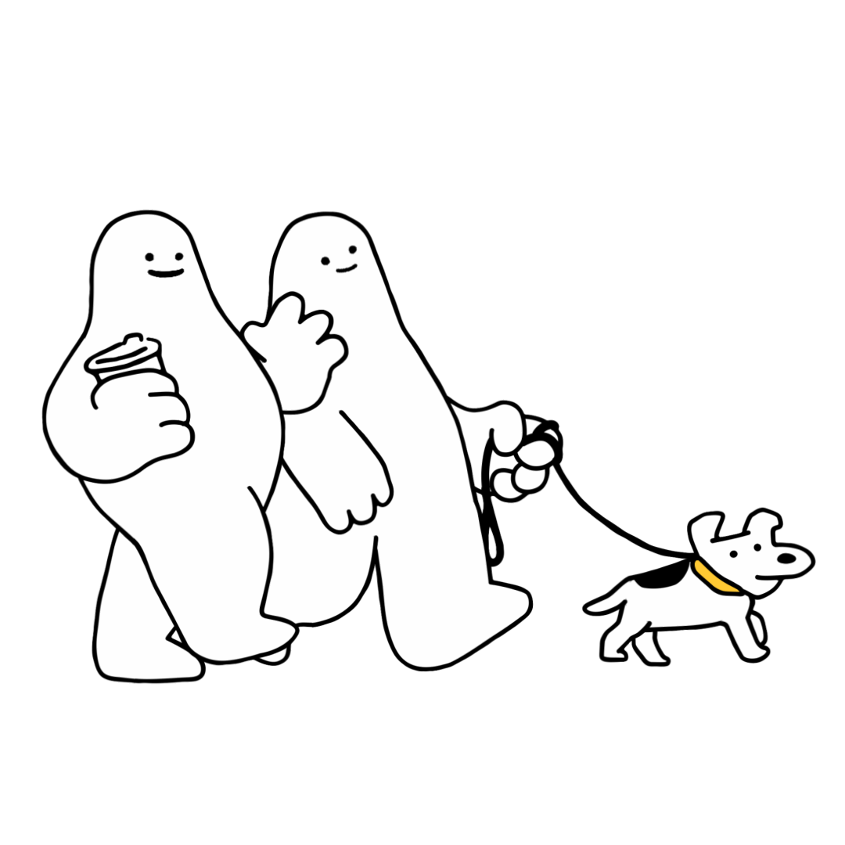
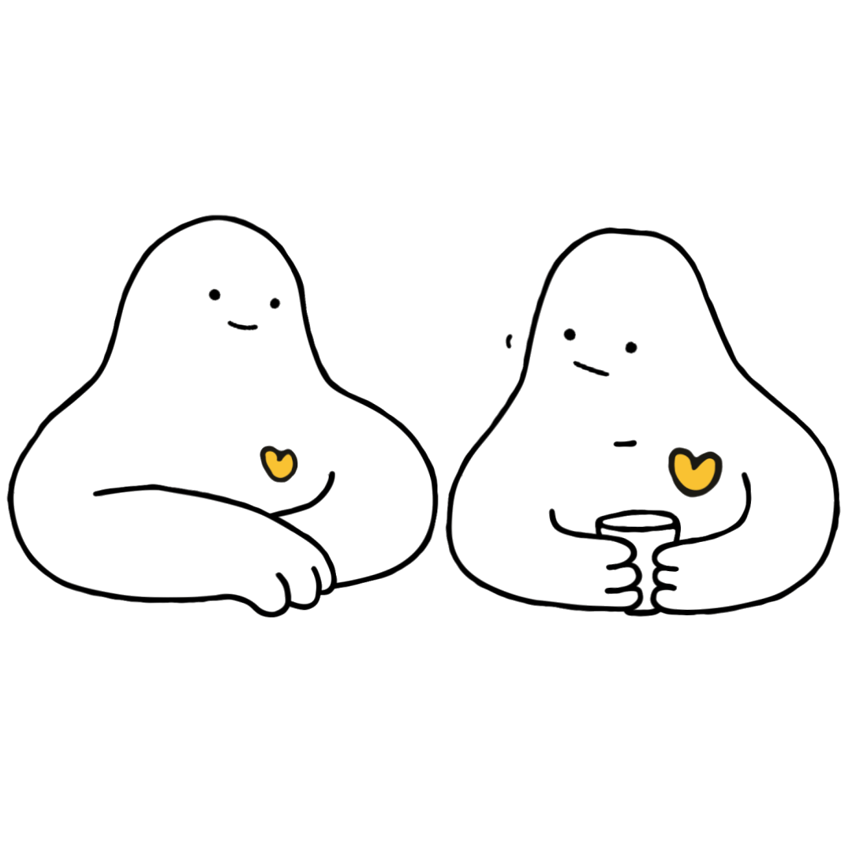
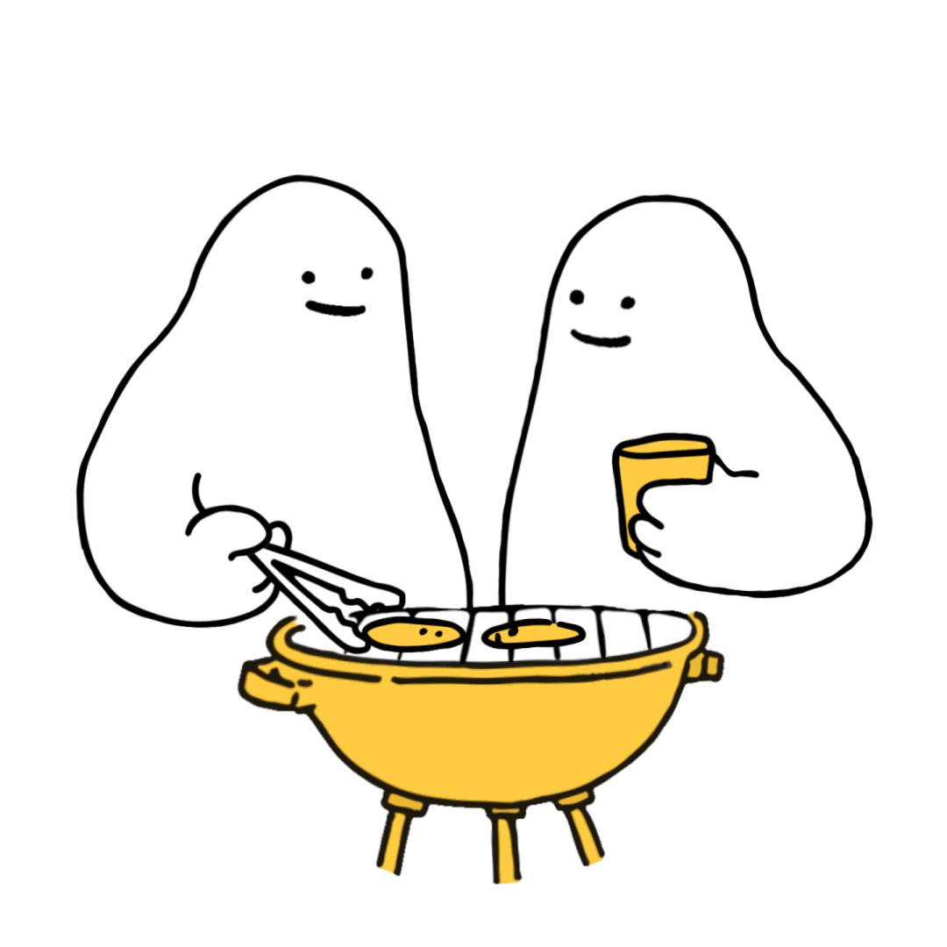
Notes:
When you’ve noticed the signs and decided that you’re ready, these are the 4 steps of an R U OK? Conversation:
Ask
Listen
Encourage Action
Check in
There’s a handy acronym of ‘ALEC’ to help you remember.

Slide 18
Notes:
Step 1: Ask
Be relaxed and friendly in your approach. Think about how you can ease into the conversation.
You don’t need to use the words, ‘are you OK?’ – you can ask in any way that feels comfortable for you and your relationship with that person.
If they don’t want to talk let them know you’ll always be ready for them when they are or ask if there’s someone else they’d be more comfortable chatting to.
You can start by letting them know you’ve noticed a change, without being accusatory. You could say something like:
“I’ve noticed a few changes in what you’ve been saying/doing. How are things for you at the moment?”
“I know there’s been some big life changes for you recently, how are you going with that?”
OR
“You don’t seem yourself lately – want to talk about it?”

Slide 19
Notes:
Step 2: Listen
Listening with an open mind can be the hardest thing to do, but it’s one of the most important parts of the conversation.
It can be tempting to jump in and try to push someone’s worries away or offer a ‘quick fix’. It can be really hard to hear that someone is in pain or struggling – but try and sit with the discomfort and remind yourself that your support can be crucial.
Avoid rushing the conversation and don’t be afraid to sit in silence.
Give the person some space and quiet so they can find the words to express what they’re going through.
You could say:
“I’m here to listen if you want to talk more”
“How are you feeling about that?”
OR
“I’m not going to pretend I know what it’s like for you, but I’m here to listen to why you feel the way you.”

Slide 20
Notes:
Once they’ve shared what they’re going through, you might suggest to them that they think about one small step they might be able to take to improve their situation.
If they’ve been feeling this way for more than two weeks they might need to see their doctor or an appropriate health professional.
You don’t have to have the answers or be able to offer professional health advice, but you can help them consider the next steps and actions they can take to manage their situation.
You could say:
“What do you think is a first step that would help you through this?”
“What can I do right now to support you?”
OR
“Have you spoken to your doctor or a health professional about this? It might be a matter of finding the right fit with someone.”

Slide 21
Notes:
Sometimes that person might need immediate support. These are some useful contacts for Australian services that are available nationally and can provide emotional and crisis support.
If at any time you feel overwhelmed by any feelings, it is important that you talk to someone you trust. A doctor, family member or friend, or make contact with one of these services.
These services can also provide you with guidance to support someone else.
You can find a directory with more services and supports on the R U OK? website: ruok.org.au
If your workplace has an Employee Assistance Programme (EAP) this is a good opportunity to remind them how to access it.

Slide 22
Notes:
After the conversation make sure you stay connected and keep checking in. Make a joint decision to spend some time together in the near future so you can see how they’re going. Your ongoing care can make a difference and make them feel supported.
When you check in you could say:
“Just wanted to check in and see how you’re doing?”
“Have things improved or changed since we last spoke?”
OR
“Do you need more support?”

Slide 23
Notes:
Those are the 4 Steps of an R U OK? Conversation:
Ask
Listen
Encourage Action
Check In
If you ever want to revisit this or access more conversation guidance to help build an R U OK? Culture, there are a number of free resources available at healthyheads.org.au/ruok

Slide 24
Notes:
Remember to ask R U OK? – No qualifications needed. A conversation could change a life.
Thank everyone for coming and take any questions if you have time.
If you don’t know the answer to a question asked, let them know that you will find out and come back to them with the answer.

